Slide 1
  Presented by Team 6
  BUSINESS ANALYTICS
  DATASET- Life Expectancy by W.H.O
1

Slide 2
  ANALYSIS COVERED:
  Descriptive
    Descriptive Statistics
    Correlation
  Diagnostic
    Testing of Hypothesis
  Predictive
    Regression
    Forecasting
  Prescriptive
    Goal Seek
  Visualization
2

Slide 3

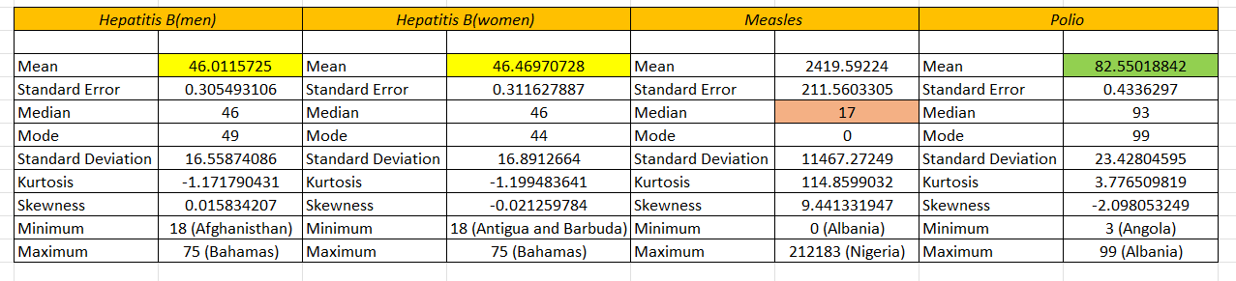
  DESCRIPTIVE ANALYSIS
  Summary Statistics
  Impact of Diseases Globally
3

Slide 4
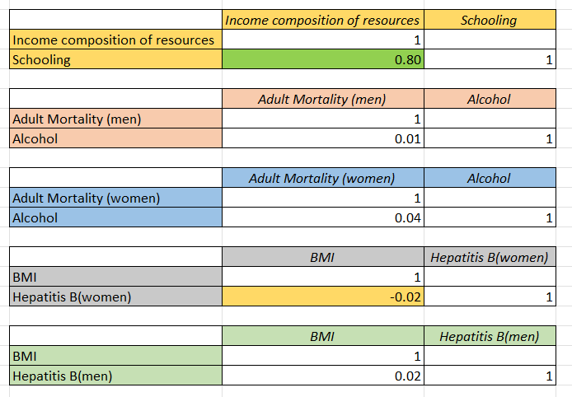
  DESCRIPTIVE ANALYSIS
  Correlation Analysis
  The more the country develops their production levels the more they develop and therby increasing the schooling
  Men tend to die less often due to the prime reason of Alcohol
  Women tend to die more often due to the prime reason of Alcohol compared to men
  BMI and Hepatits B(Women) has negative relationship
  BMI and Hepatits B(Men) have weak relationship but stronger than women
4

Slide 5
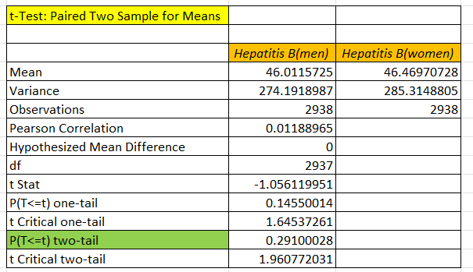
  DIAGNOSTIC ANALYSIS
  Testing of Hypothesis
  Null Hypothesis: Vaccination rates of men and women are same
  Alternative hypothesis: Vaccination rates of men and women are not same
Since the p-value (p>0.05, we fail to reject the null hypothesis.
This means there is no significant difference between the mean vaccination rates for men and women for Hepatitis B.
5

Slide 6
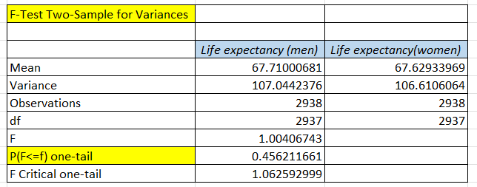
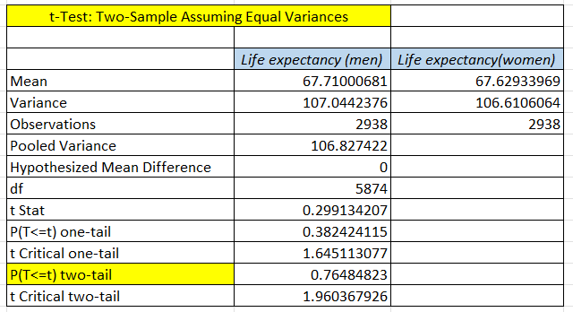
  DIAGNOSTIC ANALYSIS
  Testing of Hypothesis
  Null Hypothesis: μmen​=μwomen​
  Alternative hypothesis: μmen​ not equal to μwomen​).
  p 0.45>0.05: Null Hypothesis accepted, hence going to perform T-test assuming equal variance
  Since the p-value 0.76>0.05, we fail to reject the null hypothesis.
  This indicates there is no significant difference in life expectancy between men and women.
6

Slide 7
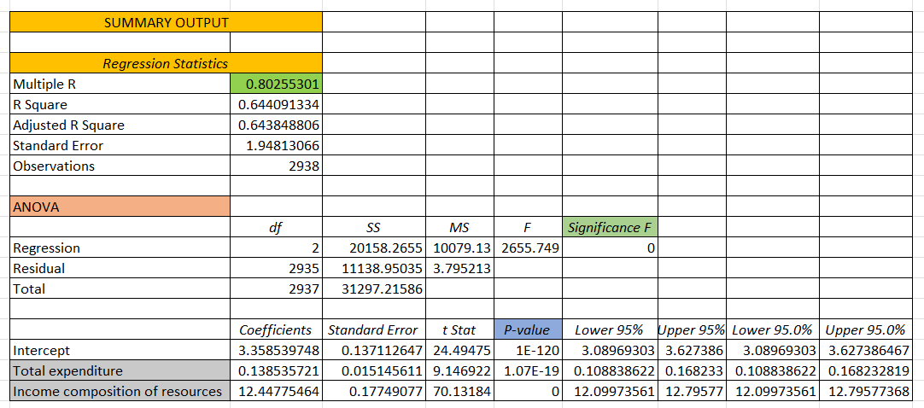
  Y (Dependent)=Schooling
  X (Independent) = Total Expenditure and Income composition of resources
  PREDICTIVE ANALYSIS
  How Total Expenditure and Income of Resources across various countries are influeing Schooling
  Regression Analysis
  Multiple R shows strong correlation between Variables
  States the Significance of Relationship
  P<0.05 shows how strongly the variables are influencing the Schooling Globally
7

Slide 8
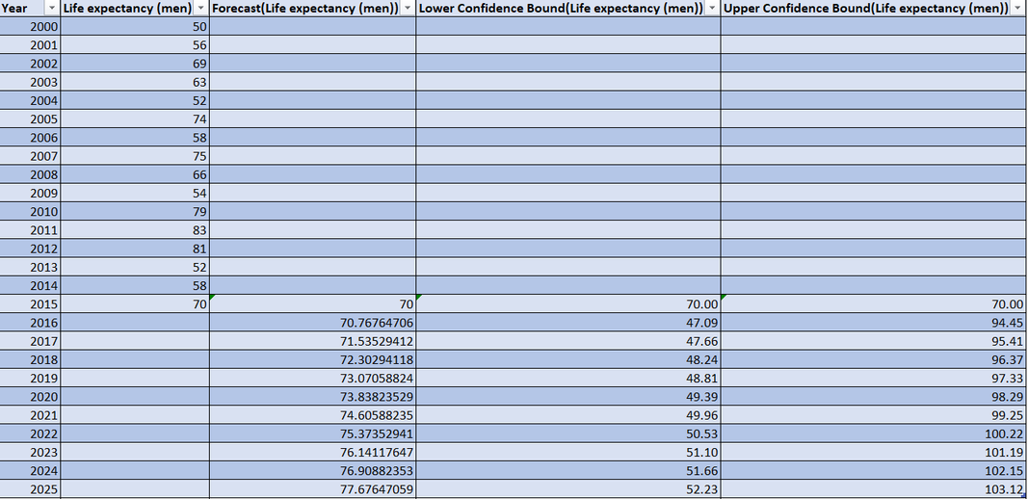
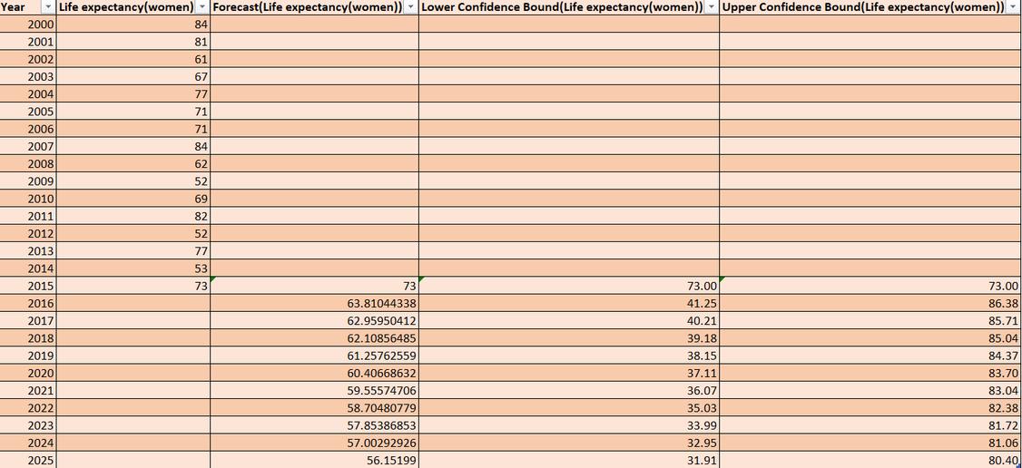
PREDICTIVE ANALYSIS
  Forecasted Life Expectancy of both Men and Women for the next 10 years
  Forecasting
  Indian Men Forecasted value for 10 years
  Indian Women Forecasted value for 10 years
8

Slide 9
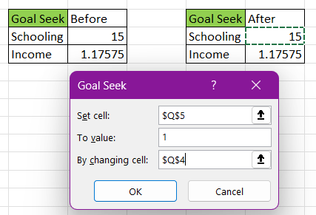
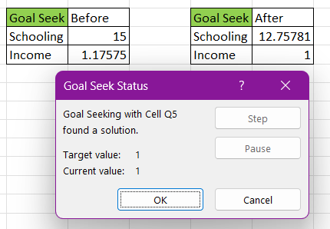
  PRESCRIPTIVE ANALYSIS
  Equation Established using Regression Analysis
  Income = 0.028426 + 0.04995707 x Schooling
  Interpretation: To reach 1 unit Income level, the respective country has to reach average schooling of 12.75 years
9

Slide 10
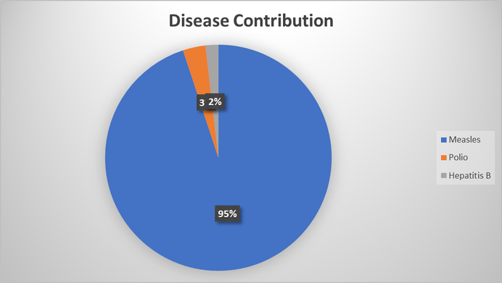
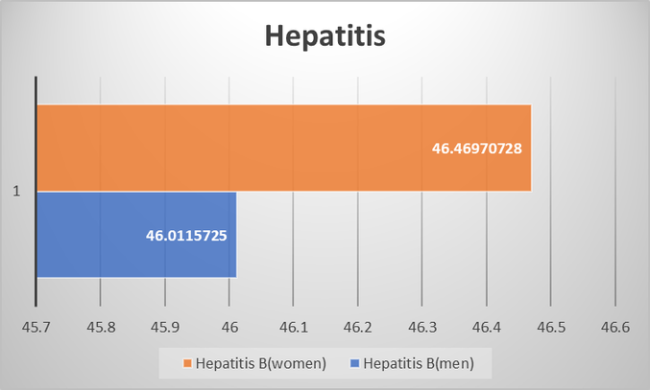
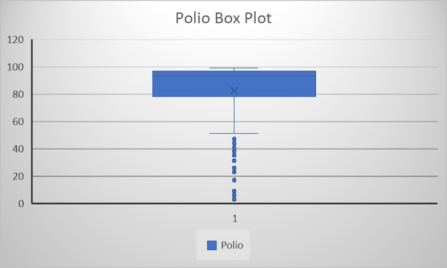
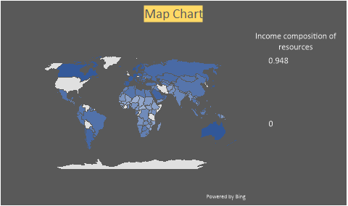
  VISUALIZATION
  PIE Chart
  BAR Chart
  BOX Plot
  Heat Maps
10

Slide 11
  Thank you very much!
  Team 6
11

